Slide 1
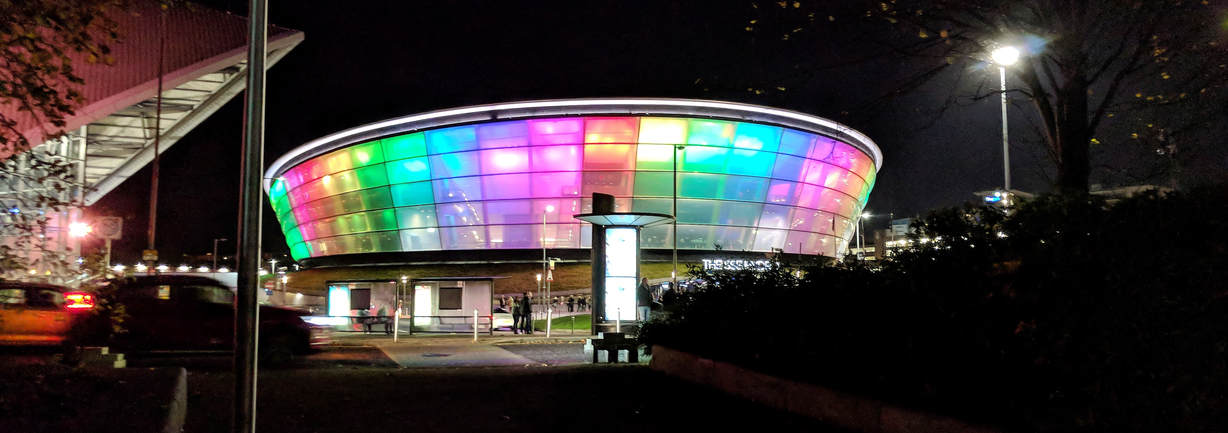
Weather Clock Build
A different type of UI for the display of the weather conditions outside

Slide 2
What am I going to talk about?
As part of the Internet of Things Ignite group I like to make up
.
I have been asked for Innovation week to tell people how I did this so they could try building IoT examples with their own ideas.

Slide 3
What am I not going to talk about?
I plan to skirt round the issues with building the actual model and concentrate on the electronic and coding parts of this build.
If anyone wants to read more details of what issues and unexpected complexity I ran into during the build you can look at my blog at http://stronans.com/blogSHK/ (though this entry is not published yet, but will be before the end of the Christmas holidays).
Those interested in the code, both for the Arduino and the Raspberry Pi will be posted at https://github.com/ksimes/ but not yet.

Slide 4
First Decisions
There were a few decisions that had to be taken into account.
I wanted to have an entirely self contained demonstration at the Science Centre so I planned to have a Wi-Fi hotspot
This really dictated that I needed a Raspberry Pi as I knew that this could be done with this device and I settled on a Pi Zero W and a set of instructions supplied by Brian Hackett who did this for the JPMC Ignite Escape Room
I wanted the Hydro Model to be in full colour and I knew that I could control RGB LED using Servo controllers (PCA9685 16 Channel 12-Bit PWM Servo Motor Driver)
I knew that I wanted it to be fairly small and transportable so I planned to make it no bigger than an A4 sized base

Slide 5
First set of electronics

Slide 6
Problems with design
This initial set of electronics threw up some obvious problems:
The set of electronic was far too big for the size of model in mind
I would have to code all of the different patterns of lights I wanted and work out a control mechanism for each of them
I would also have to host the Wi-Fi hotspot, the front end and the back end as well as the lights controller all on a small memory computer
There were a lot of wires to go wrong!

Slide 7
Second attempt
I cannot remember who suggested to me about using addressable LED lights, but thank you whoever it was.
I got hold from Amazon of a set of 5m long, WS2812B, 150 elements individually addressable full colour LED strip
I also looked around for a programming library for these but could only find a Python one. As I planned to do all of the other coding in Java this left me a few issues.
I resolved this by deciding to use a Arduino Nano and a communications library I had to communicate between the Raspberry Pi and the Arduino.
I found that the strip of LEDs could be cut down and used at any length so decided that I only wanted to use the first 16

Slide 8


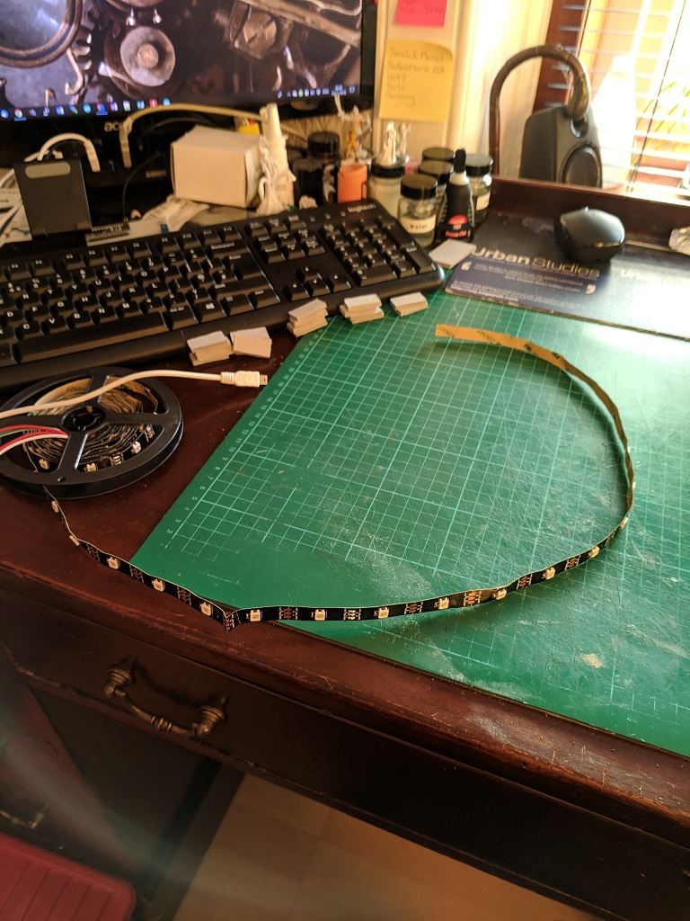
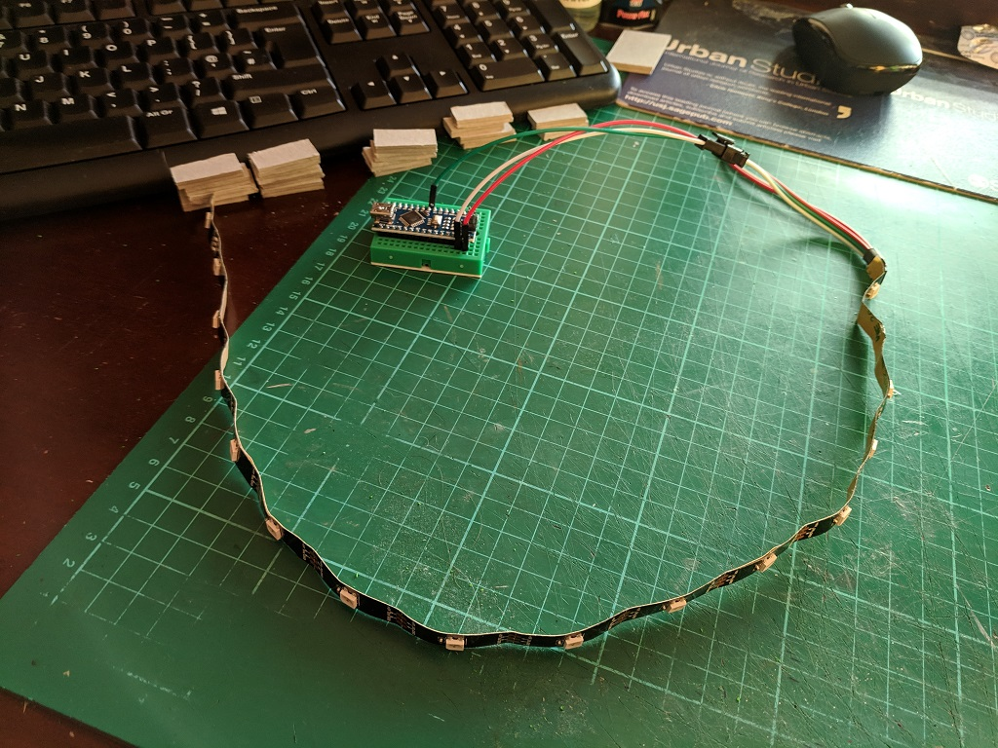



New configuration

Slide 9
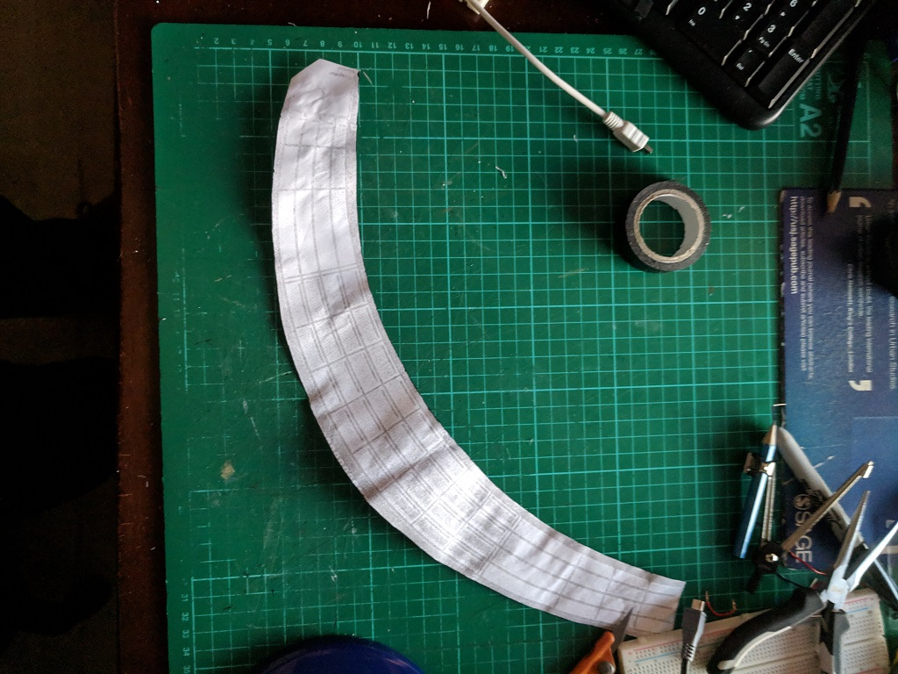
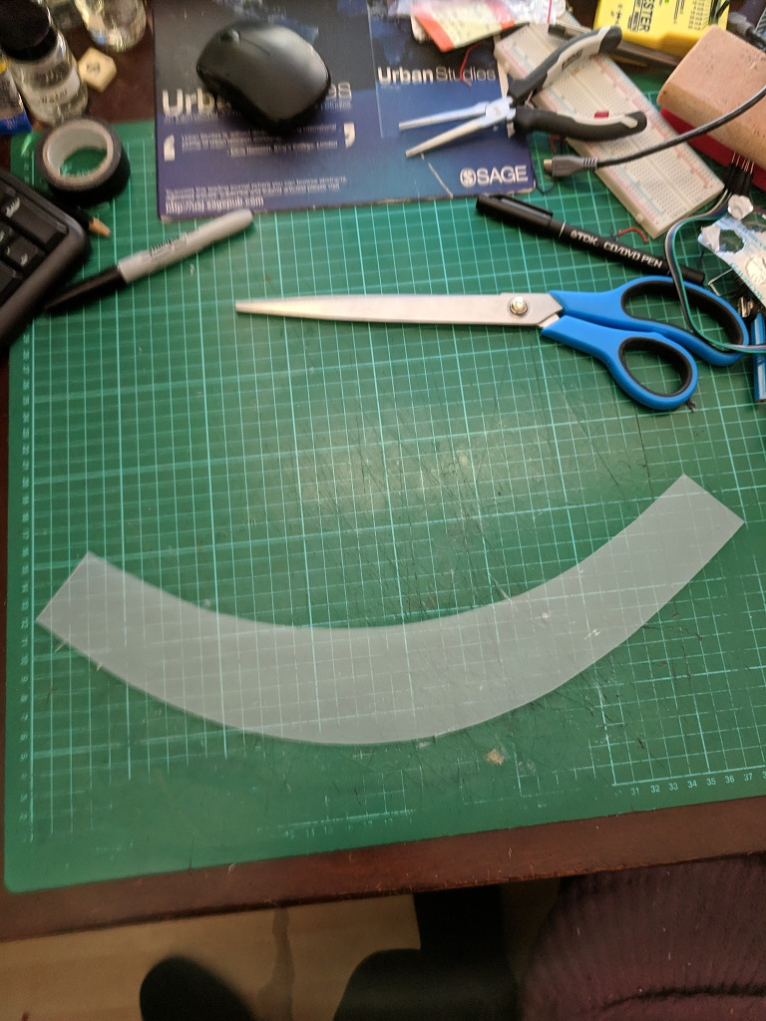
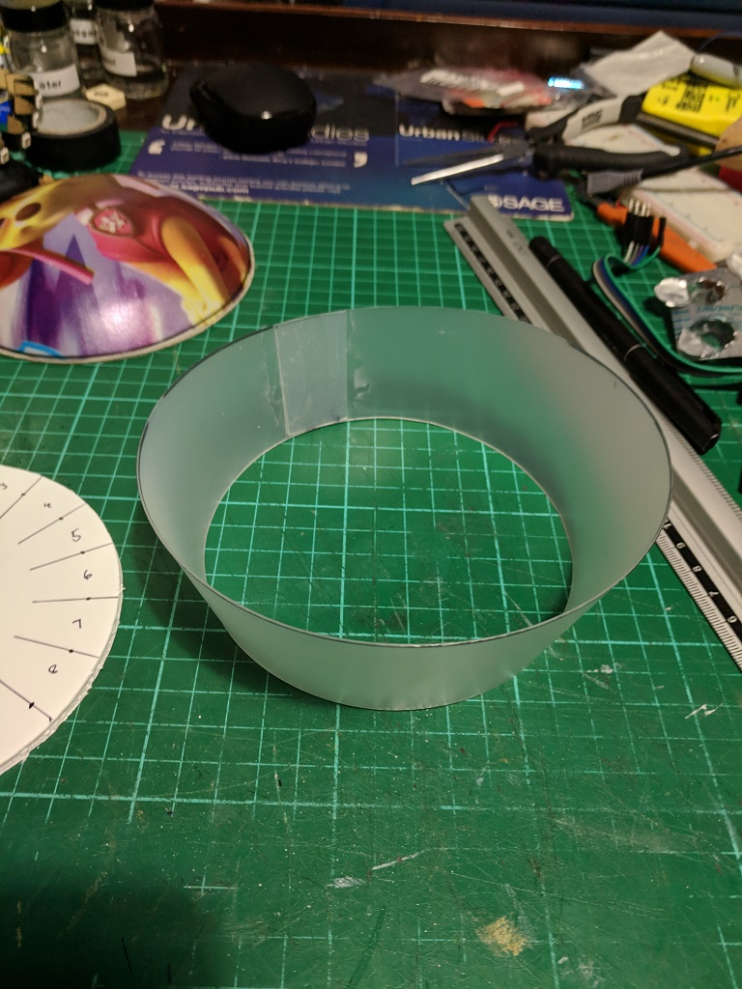
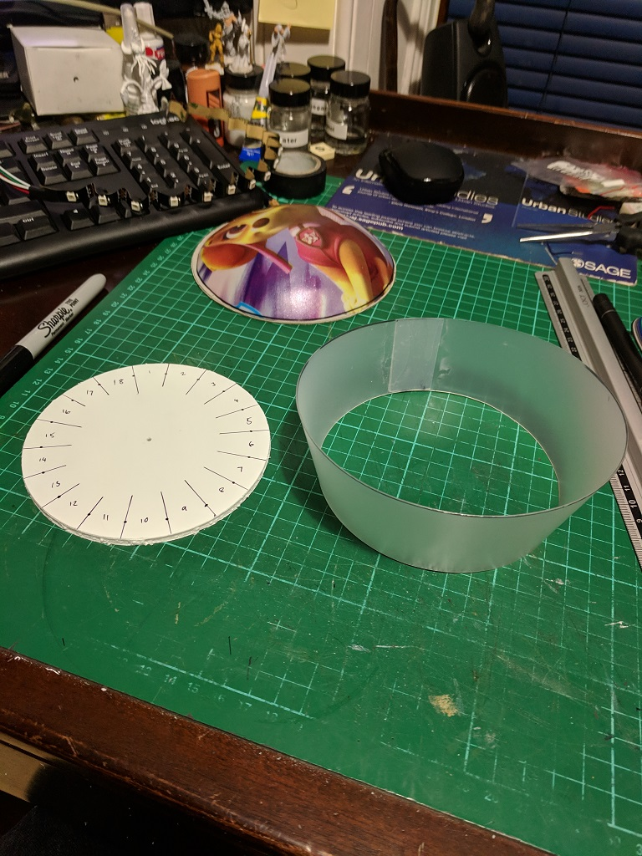
Model build

Slide 10
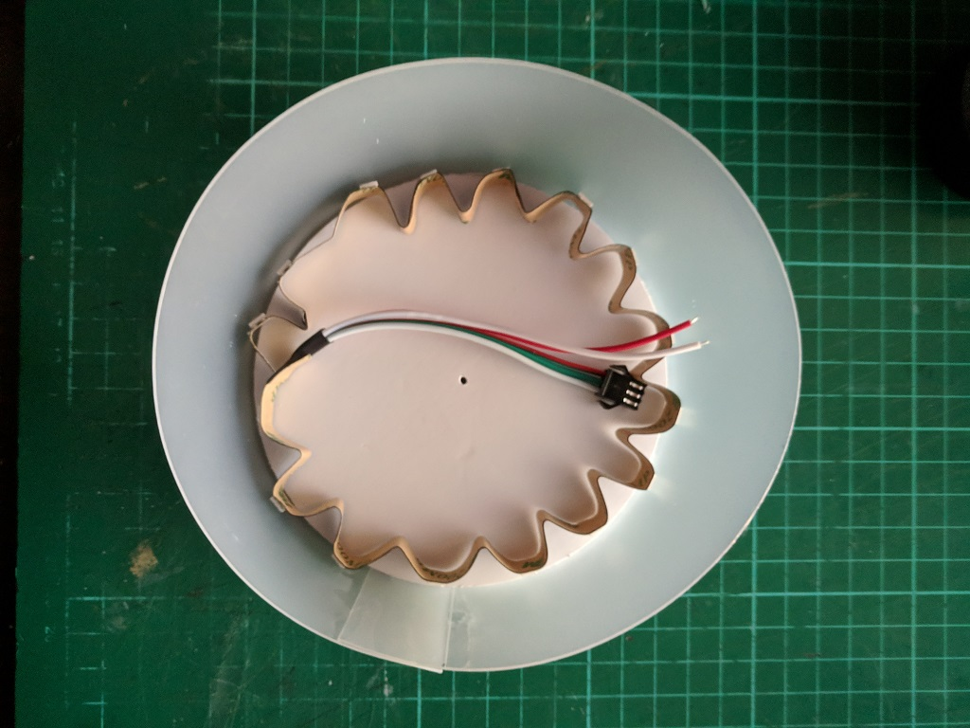
Quick try of the LEDs sitting in the final shell

Slide 11
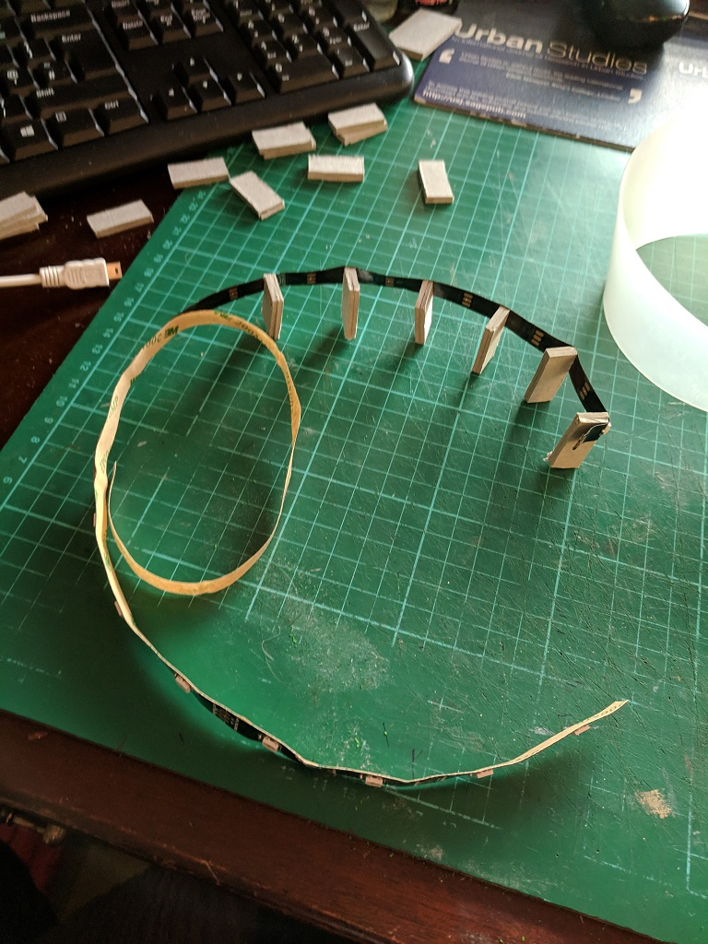
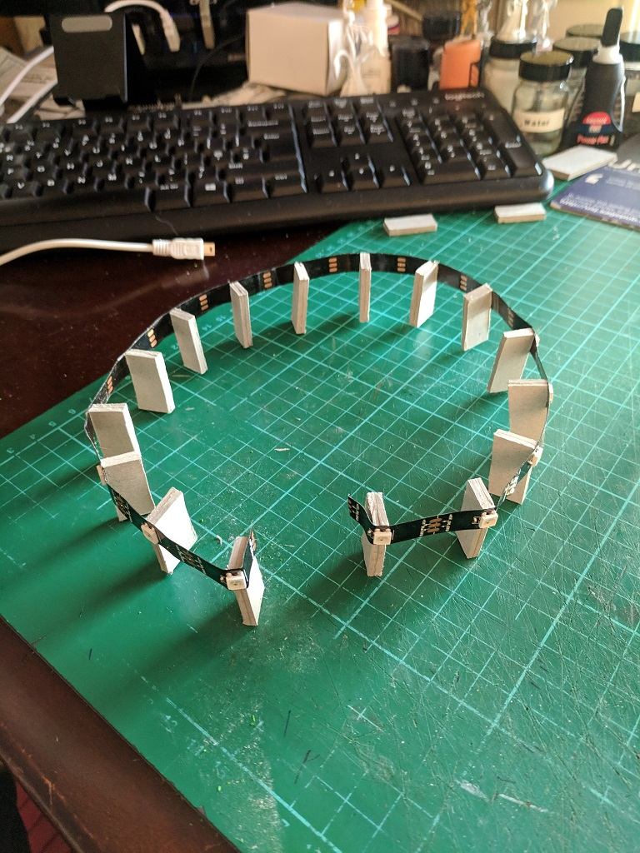
Putting it all together

Slide 12
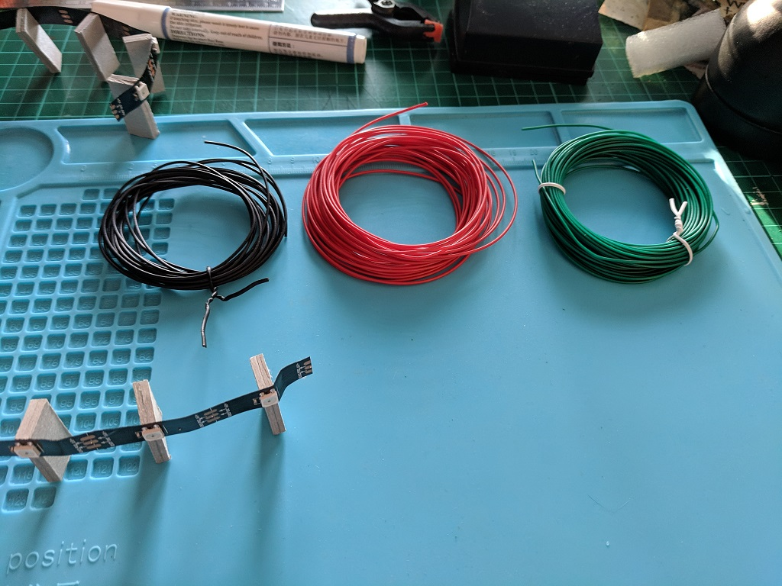
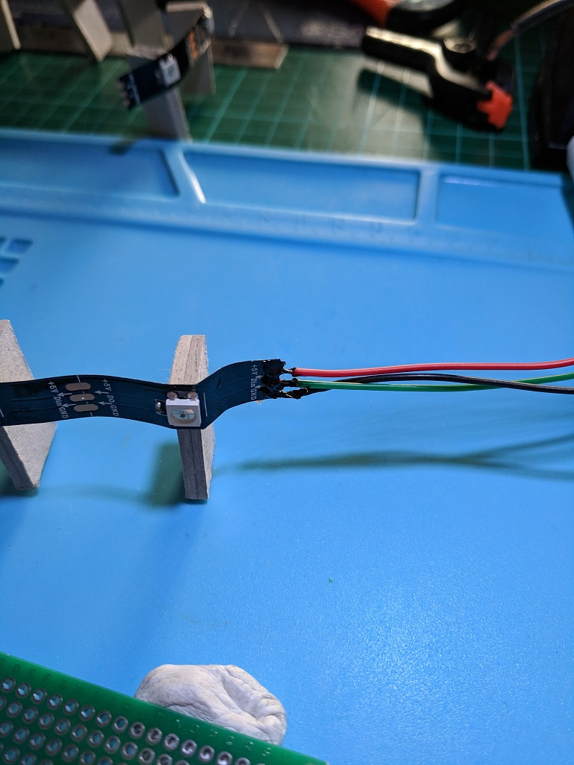
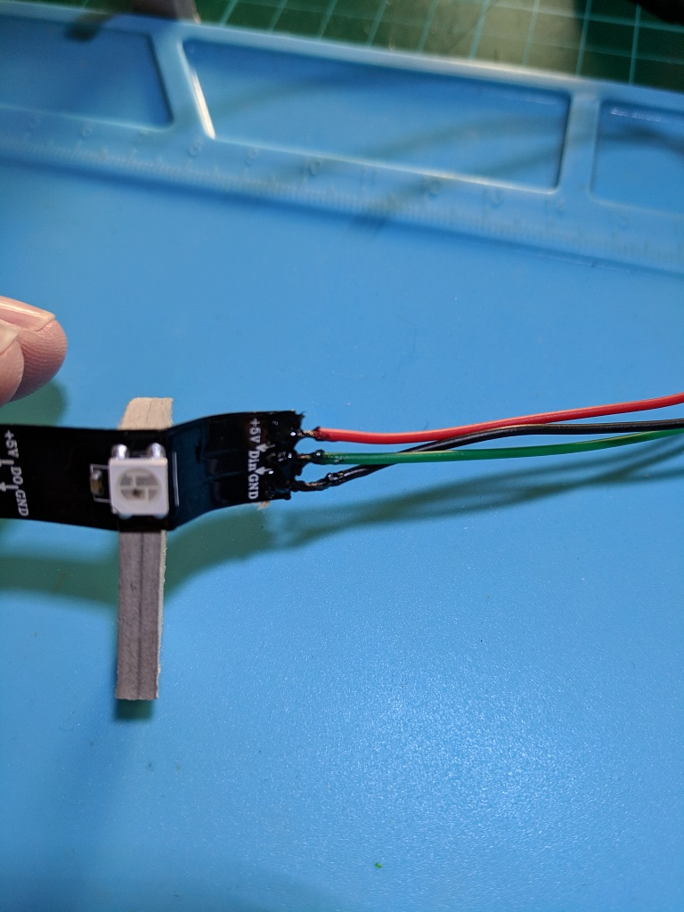
Soldering new wires in place

Slide 13
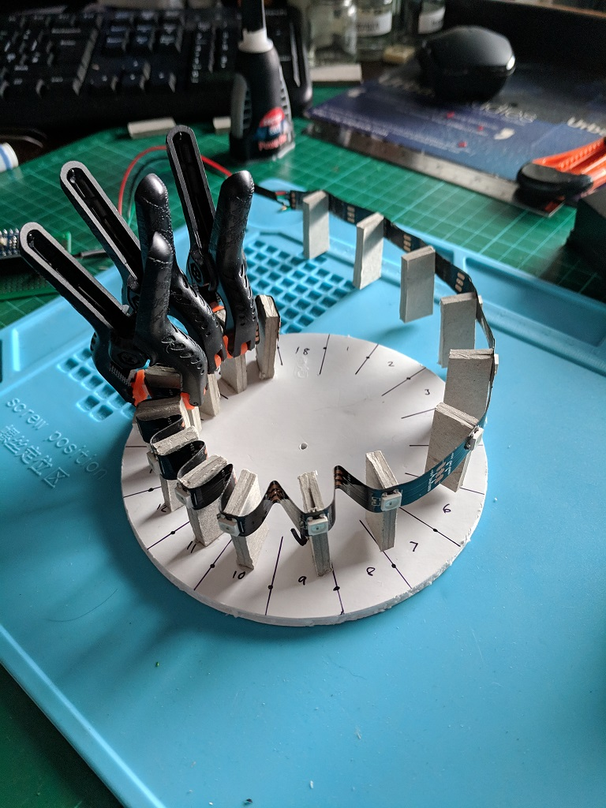
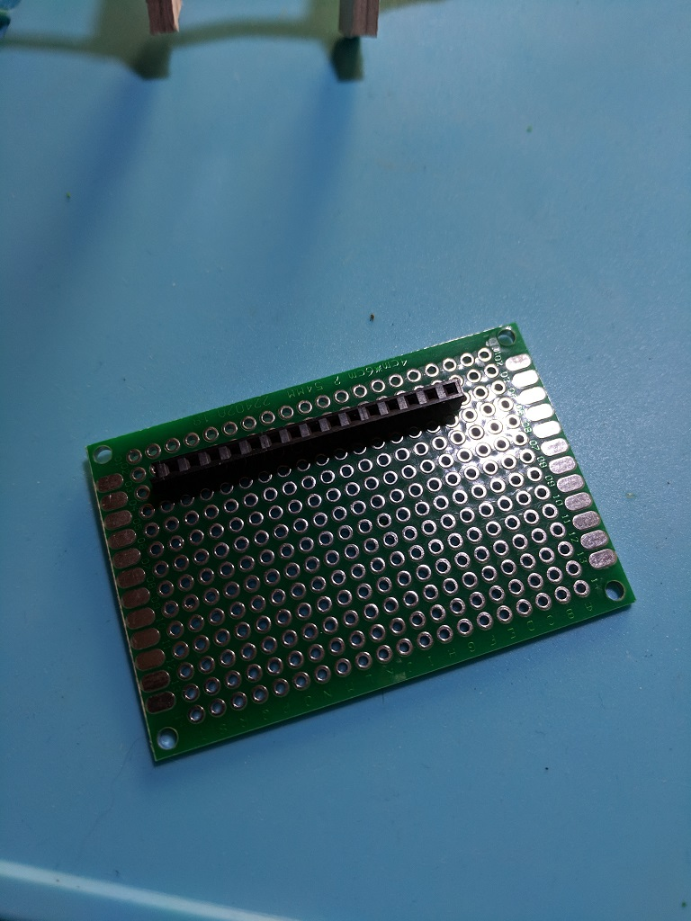
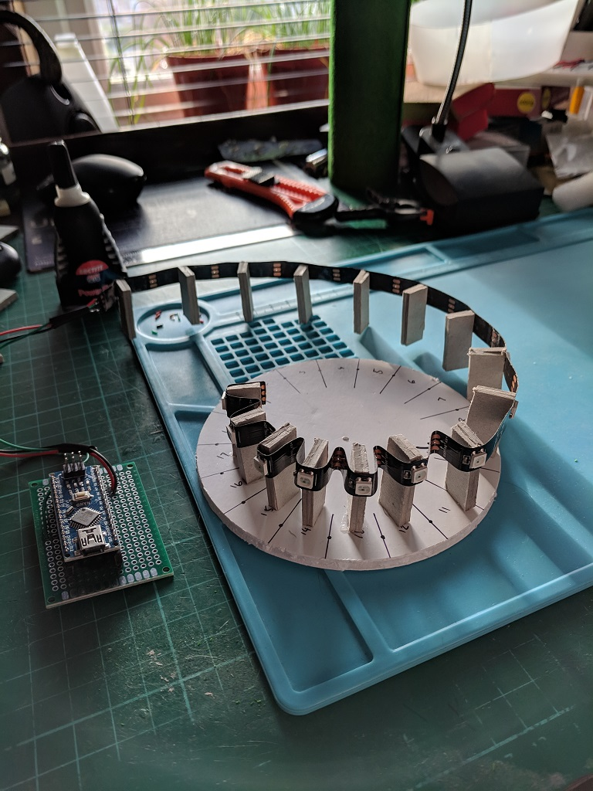
Slotting in the Electronics

Slide 14
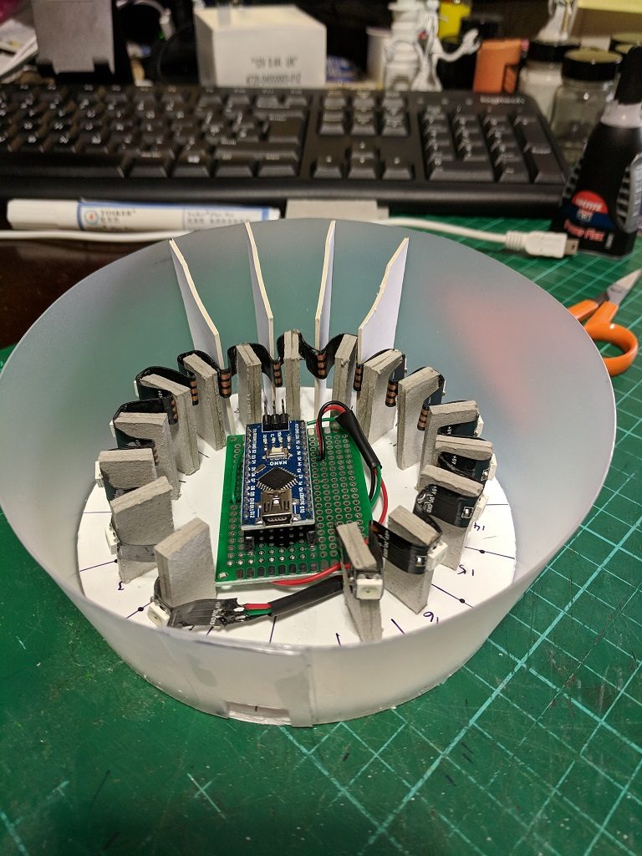
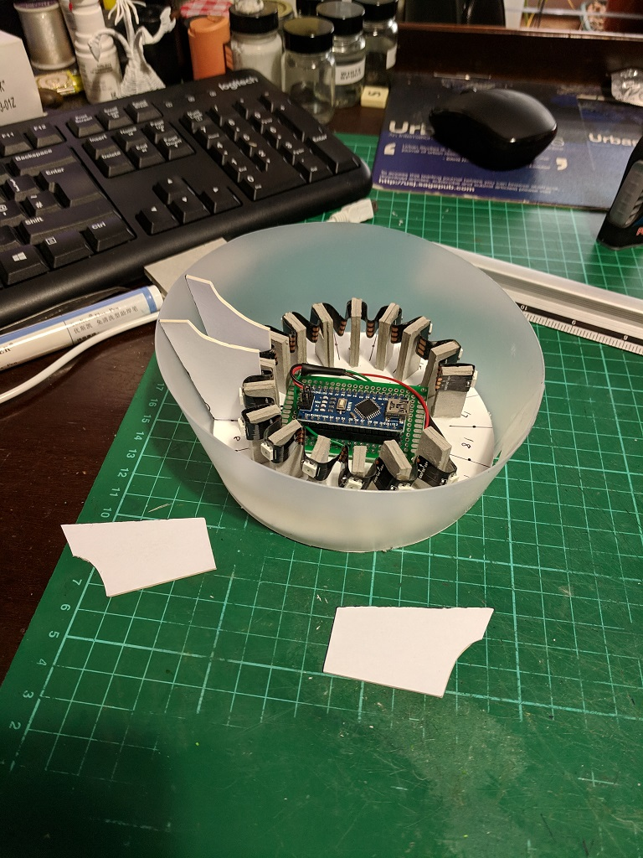
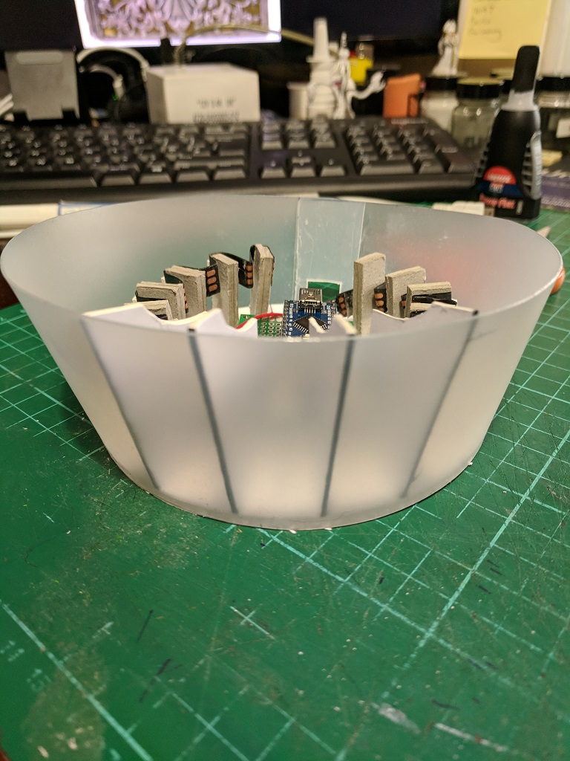
Final Steps

Slide 15
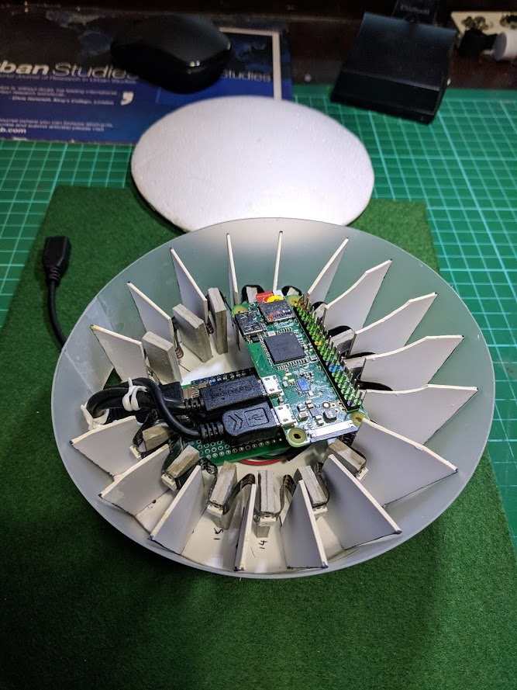
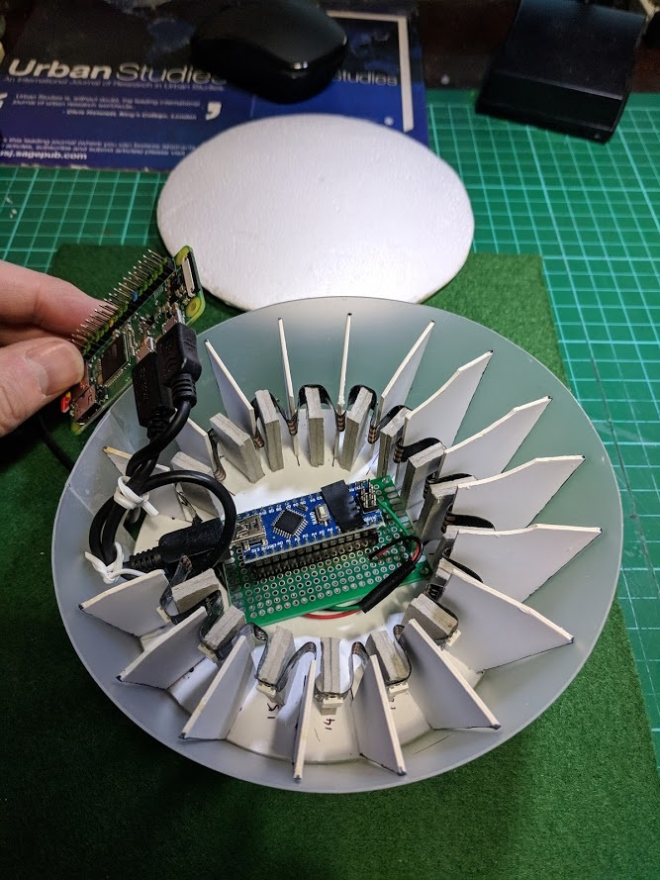
Completed build

